Slide 1
Vector Semantics & Embeddings
Word Meaning
Notes:
Let's begin with some linguistic background on word meaning

Slide 2
What do words mean?
N-gram or text classification methods we've seen so far
Words are just strings (or indices w_{i} in a vocabulary list)
That's not very satisfactory!
Introductory logic classes:
The meaning of "dog" is DOG; cat is CAT
∀x DOG(x) ⟶ MAMMAL(x)
Old linguistics joke by Barbara Partee in 1967:
Q: What's the meaning of life?
A: LIFE
That seems hardly better!
Notes:
How do we represent the meaning of words in NLP systems? in classical NLP applications, our only representation of a word is as a string of letters, or an index in a vocabulary list.
This representation is not that different from a tradition in philosophy, perhaps you’ve seen it in introductory logic classes, in which the meaning of words is represented by just spelling the word with small capital letters; representing the meaning of “dog” as DOG, and “cat” as CAT.
Representing the meaning of a word by capitalizing it is a pretty unsatisfactory model. You might have seen a joke due originally to semanticist Barbara Partee (Carlson, 1977):
Q: What’s the meaning of life? A: LIFE’
Surely we can do better than this

Slide 3
Desiderata
What should a theory of word meaning do for us?
Let's look at some desiderata
From lexical semantics, the linguistic study of word meaning

Slide 4
Lemmas and senses
lemma
mouse (N) 1. any of numerous small rodents... 2. a hand-operated device that controls a cursor...
sense
Modified from the online thesaurus WordNet
A sense or “concept” is the meaning component of a word
Lemmas can be polysemous (have multiple senses)

Slide 5
Relations between senses: Synonymy
Synonyms have the same meaning in some or all contexts.
filbert / hazelnut
couch / sofa
big / large
automobile / car
vomit / throw up
water / H₂0

Slide 6
Relations between senses: Synonymy
Note that there are probably no examples of perfect synonymy.
Even if many aspects of meaning are identical
Still may differ based on politeness, slang, register, genre, etc.

Slide 7
Relation: Synonymy?
water/H₂0
"H₂0" in a surfing guide?
big/large
my big sister != my large sister
Notes:
For example, the word H2O is used in scientific contexts and would be inappropriate in a surfing guide—water would be more appropriate— and this genre difference is part of the meaning of the word. In practice, the word synonym is therefore used to describe a relationship of approximate or rough synonymy.

Slide 8
The Linguistic Principle of Contrast
Difference in form → difference in meaning
Notes:
In practice, the word synonym is therefore used to describe a relationship of approximate or rough synonymy,

Slide 9
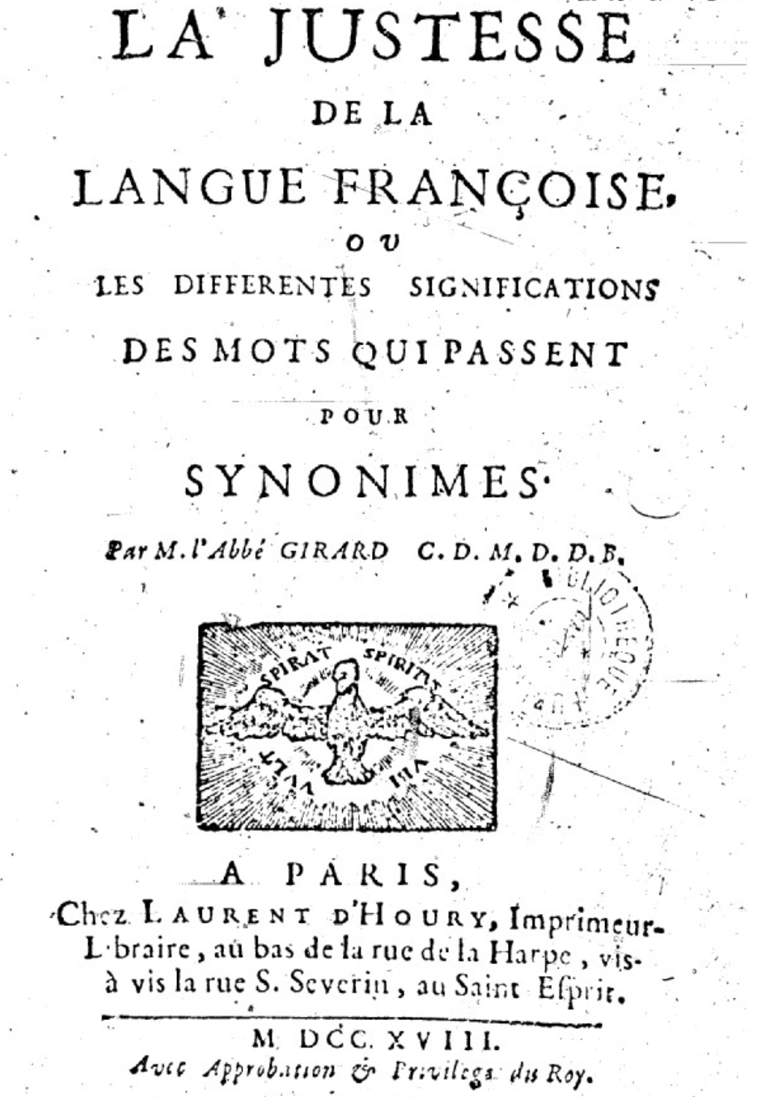
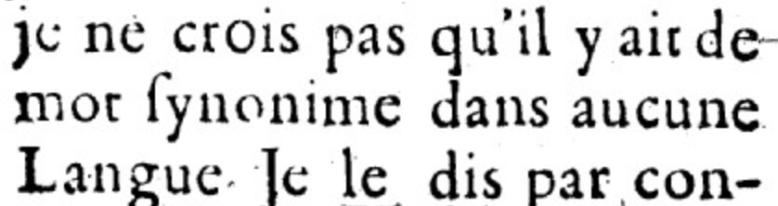
Abbé Gabriel Girard 1718
Re: "exact" synonyms
"
"
[I do not believe that there is a synonymous word in any language]
Thanks to Mark Aronoff!
Notes:
One of the fundamental tenets of semantics, called the principle of contrast, states that a difference in linguistic form is always associated with some difference in meaning.

Slide 10
Relation: Similarity
Words with similar meanings. Not synonyms, but sharing some element of meaning
car, bicycle
cow, horse
Notes:
While words don’t have many synonyms, most words do have lots of similar words. Cat is not a synonym of dog, but cats and dogs are certainly similar words. The notion of word similarity is very useful in larger semantic tasks. Know- ing how similar two words are can help in computing how similar the meaning of two phrases or sentences are, a very important component of natural language un- derstanding tasks like question answering, paraphrasing, and summarization.

Slide 11
Ask humans how similar 2 words are
word1 | word2 | similarity
vanish | disappear | 9.8
behave | obey | 7.3
belief | impression | 5.95
muscle | bone | 3.65
modest | flexible | 0.98
hole | agreement | 0.3
SimLex-999 dataset (Hill et al., 2015)
Notes:
One way of getting values for word similarity is to ask humans to judge how similar one word is to another. A number of datasets have resulted from such experiments. For example the SimLex-999 dataset (Hill et al., 2015) gives values on a scale from 0 to 10, from near-synonyms (vanish, disappear) to pairs that scarcely seem to have anything in common (hole, agreement):

Slide 12
Relation: Word relatedness
Also called "word association"
Words can be related in any way, perhaps via a semantic frame or field
coffee, tea: similar
coffee, cup: related, not similar
Notes:
The meaning of two words can be related in ways other than similarity. One such class of connections is called word relatedness (Budanitsky
and Hirst, 2006), also traditionally called word association in psychology. Coffee is similar to tea. But coffee is not similar to cup; they share practically no features (coffee is a plant or a beverage, while a cup is a manufactured object with a particular shape). But coffee and cup are clearly related; they are associated by co-participating in an everyday event (the event of drinking coffee out of a cup). Similarly scalpel and surgeon are not similar but are related
eventively (a surgeon tends to make use of a scalpel).

Slide 13
Semantic field
Words that
cover a particular semantic domain
bear structured relations with each other.
hospitals
surgeon, scalpel, nurse, anaesthetic, hospital
restaurants
waiter, menu, plate, food, menu, chef
houses
door, roof, kitchen, family, bed
Notes:
One common kind of relatedness between words is if they belong to the same
semantic field. A semantic field is a set of words which cover a particular semantic domain and bear structured relations with each other. For example, words might be related by being in the semantic field of hospitals (surgeon, scalpel, nurse, anes- thetic, hospital), restaurants (waiter, menu, plate, food, chef), or houses (door, roof, kitchen, family, bed).

Slide 14
Relation: Antonymy
Senses that are opposites with respect to only one feature of meaning
Otherwise, they are very similar!
dark/light short/long fast/slow rise/fall
hot/cold up/down in/out
More formally: antonyms can
define a binary opposition or be at opposite ends of a scale
long/short, fast/slow
Be reversives:
rise/fall, up/down

Slide 15
Connotation (sentiment)
Words have affective meanings
Positive connotations (happy)
Negative connotations (sad)
Connotations can be subtle:
Positive connotation: copy, replica, reproduction
Negative connotation: fake, knockoff, forgery
Evaluation (sentiment!)
Positive evaluation (great, love)
Negative evaluation (terrible, hate)
Notes:
Finally, words have affective meanings or connotations. The word connotation has different meanings in different fields, but here we use it to mean the aspects of a word’s meaning that are related to a writer or reader’s emotions, sentiment, opinions, or evaluations. For example some words have positive conno- tations (happy) while others have negative connotations (sad). Even words whose meanings are similar in other ways can vary in connotation; consider the difference in connotations between fake, knockoff, forgery, on the one hand, and copy, replica, reproduction on the other
Some words describe positive evaluation (great, love) and others neg- ative evaluation (terrible, hate). Positive or negative evaluation language is called sentiment, as we saw already, and word sentiment plays a role in important tasks like sentiment analysis, stance detection, and applications of NLP to the lan- guage of politics and consumer reviews.

Slide 16
Connotation
Osgood et al. (1957)
Words seem to vary along 3 affective dimensions:
valence: the pleasantness of the stimulus
arousal: the intensity of emotion provoked by the stimulus
dominance: the degree of control exerted by the stimulus
 | Word | Score |  | Word | Score
Valence | love | 1.000 |  | toxic | 0.008
 | happy | 1.000 |  | nightmare | 0.005
Arousal | elated | 0.960 |  | mellow | 0.069
 | frenzy | 0.965 |  | napping | 0.046
Dominance | powerful | 0.991 |  | weak | 0.045
 | leadership | 0.983 |  | empty | 0.081
Values from NRC VAD Lexicon (Mohammad 2018)
Notes:
Early work on affective meaning (Osgood et al., 1957) found that words varied along three important dimensions of affective meaning:

Slide 17
So far
Concepts or word senses
Have a complex many-to-many association with words (homonymy, multiple senses)
Have relations with each other
Synonymy
Antonymy
Similarity
Relatedness
Connotation

Slide 18
Vector Semantics & Embeddings
Word Meaning
Notes:
We've introduced some basic aspects of word meaning, which give us some desiderata for building a computational model.

Slide 19
Vector Semantics & Embeddings
Vector Semantics
Notes:
Here we introduce Vector Semantics, the standard way to represent word meaning in language processing

Slide 20
Computational models of word meaning
Can we build a theory of how to represent word meaning, that accounts for at least some of the desiderata?
We'll introduce vector semantics
The standard model in language processing!
Handles many of our goals!
Notes:
Vector semantics is the standard way to represent word meaning in NLP, helping us model many of the aspects of word meaning we saw in the previous section. The roots of the model lie in the 1950s when two big ideas converged:

Slide 21
Ludwig Wittgenstein
PI #43:
"The meaning of a word is its use in the language"
Notes:
The first draws on the philosopher Wittgenstein's idea that the meaning of a word should be tied to how it is used

Slide 22
Let's define words by their usages
One way to define "usage":
words are defined by their environments (the words around them)
Zellig Harris (1954):
If A and B have almost identical environments we say that they are synonyms.
Notes:
linguists like Joos (1950), Harris (1954), and Firth (1957) had the related idea of defining the meaning of a word by its distribution in language use, meaning its neighboring words or grammatical environments.

Slide 23
What does recent English borrowing ongchoi mean?
Suppose you see these sentences:
Ong choi is delicious sautéed with garlic.
Ong choi is superb over rice
Ong choi leaves with salty sauces
And you've also seen these:
…spinach sautéed with garlic over rice
Chard stems and leaves are delicious
Collard greens and other salty leafy greens
Conclusion:
Ongchoi is a leafy green like spinach, chard, or collard greens
We could conclude this based on words like "leaves" and "delicious" and "sauteed"
Notes:
For example, suppose you didn’t know the meaning of the word ongchoi (a recent borrowing from Cantonese) but you see it in the following contexts:
…
We can do the same thing computationally by just counting words in the context of ongchoi.

Slide 24

Ongchoi: Ipomoea aquatica "Water Spinach"
空心菜
kangkong
rau muống
…
Yamaguchi, Wikimedia Commons, public domain
Notes:
Here's a picture of ongchoi for you food fans

Slide 25
Idea 1: Defining meaning by linguistic distribution
Let's define the meaning of a word by its distribution in language use, meaning its neighboring words or grammatical environments.
Notes:
So we can express this first intuition as Idea 1:

Slide 26
Idea 2: Meaning as a point in space (Osgood et al. 1957)
3 affective dimensions for a word
valence: pleasantness
arousal: intensity of emotion
dominance: the degree of control exerted
Hence the connotation of a word is a vector in 3-space
 | Word | Score |  | Word | Score
Valence | love | 1.000 |  | toxic | 0.008
 | happy | 1.000 |  | nightmare | 0.005
Arousal | elated | 0.960 |  | mellow | 0.069
 | frenzy | 0.965 |  | napping | 0.046
Dominance | powerful | 0.991 |  | weak | 0.045
 | leadership | 0.983 |  | empty | 0.081
NRC VAD Lexicon
(Mohammad 2018)
Notes:
And the second idea is Osgood’s (1957) idea mentioned in the prior lecture, in which the connotation of a word is represented by 3 numbers, it's valence, arousal, and dominance. That means we are essentially representing a word's connotation by a point in three-dimensional space! But suppose we represent more than just a word's connotation

Slide 27
Idea 1: Defining meaning by linguistic distribution Idea 2: Meaning as a point in multidimensional space
Notes:
So we're going to combine these two ideas:

Slide 28
Defining meaning as a point in space based on distribution
Each word = a vector (not just "good" or "w₄₅")
Similar words are "nearby in semantic space"
We build this space automatically by seeing which words are nearby in text
Notes:
In vector semantics, we define meaning as a point in space based on distribution. Each word is a vector, not just a string like "good" or an index like "w_45". Similar words are nearby in semantic space, and, crucially, as we'll see, we build this space automatically by seeing which words are nearby in text. Here we see shows a visualization of embeddings learned for sentiment analysis, showing the location of selected words projected down from 60-dimensional space into a two dimensional space. Notice the distinct regions containing positive words, negative words, and neutral function words.

Slide 29
We define meaning of a word as a vector
Called an "embedding" because it's embedded into a space (see textbook)
The standard way to represent meaning in NLP
Every modern NLP algorithm uses embeddings as the representation of word meaning
Fine-grained model of meaning for similarity

Slide 30
Intuition: why vectors?
Consider sentiment analysis:
With words, a feature is a word identity
Feature 5: 'The previous word was "terrible"'
requires exact same word to be in training and test
With embeddings:
Feature is a word vector
'The previous word was vector [35,22,17…]
Now in the test set we might see a similar vector [34,21,14]
We can generalize to similar but unseen words!!!

Slide 31
We'll discuss 2 kinds of embeddings
tf-idf
Information Retrieval workhorse!
A common baseline model
Sparse vectors
Words are represented by (a simple function of) the counts of nearby words
Word2vec
Dense vectors
Representation is created by training a classifier to predict whether a word is likely to appear nearby
Later we'll discuss extensions called contextual embeddings

Slide 32
From now on: Computing with meaning representations instead of string representations

Slide 33
Vector Semantics & Embeddings
Vector Semantics

Slide 34
Vector Semantics & Embeddings
Words and Vectors
Notes:
Let's talk about how to represent words as simple vectors of context counts

Slide 35
Term-document matrix
Each document is represented by a vector of words
Notes:
Imagine we have a collection of documents, such as all the works of Shakespeare. We can represent documents in such a collection by a term-document matrix, in which each row represents a word in the vocabulary and each column represents a document from the collection. Here's a small selection from a term-document matrix showing the occurrence of four words in four plays by Shakespeare. Each cell in this matrix represents the number of times a particular word (defined by the row) occurs in a particular document (defined by the column). Thus fool appeared 58 times in Twelfth Night. We can think of each column as a vector representing for a document as a point in |V |-dimensional space; thus the documents in here are points in 4-dimensional space.

Slide 36
Visualizing document vectors
Notes:
A spatial visualization of the document vectors for the four Shakespeare play documents, showing just two of the dimensions, corresponding to the words battle and fool. The comedies have high values for the fool dimension and low values for the battle dimension.

Slide 37
Vectors are the basis of information retrieval
Vectors are similar for the two comedies
But comedies are different than the other two
Comedies have more fools and wit and fewer battles.
Notes:
Two documents that are similar will tend to have similar words, and if two documents have similar words their column vectors will tend to be similar. The vectors for the comedies As You Like It [1,114,36,20] and Twelfth Night [0,80,58,15] look a lot more like each other (more fools and wit than battles) than they look like Julius Caesar [7,62,1,2] or Henry V [13,89,4,3]. A real term-document matrix, of course, wouldn’t just have 4 rows and columns, let alone 2. More generally, the term-document matrix has |V| rows (one for each word type in the vocabulary) and D columns, one for each document in the collection.

Slide 38
Idea for word meaning: Words can be vectors too!!!
battle is "the kind of word that occurs in Julius Caesar and Henry V"
fool is "the kind of word that occurs in comedies, especially Twelfth Night"
Notes:
Here's the new idea: vector semantics can also be used to represent the meaning of words. We do this by associating each word with a word vector— a row vector rather than a column vector, hence with different dimensions, as we see here. The four dimensions of the vector for fool, [36,58,1,4], correspond to the four Shakespeare plays. For documents, we saw that similar documents had similar vectors, because similar documents tend to have similar words. This same principle applies to words: similar words have similar vectors because they tend to occur in similar documents. The term-document matrix thus lets us represent the meaning of a word by the documents it tends to occur in.

Slide 39
More common: word-word matrix (or "term-context matrix")
Two words are similar in meaning if their context vectors are similar
Notes:
An alternative to using the term-document matrix to represent words as vectors of document counts, is to use the term-term matrix, also called the word-word matrix or the term-context matrix, in which the columns are labeled by words rather than documents. This matrix is thus of dimensionality |V | × |V | and each cell records the number of times the row (target) word and the column (context) word co-occur in some context in some training corpus.
The context could be the document, in which case the cell represents the number of times the two words appear in the same document. It is most common, however, to use smaller contexts, generally a window around the word, for example of 4 words to the left and 4 words to the right, in which case the cell represents the number of times (in some training corpus) the column word occurs in such a ±4 word window around the row word. For example here is one example each of some words in their windows with counts from a Wikipedia corpus. Note that digital and information are more similar to each other than, say, to strawberry.

Slide 40
Notes:
Here's a spatial visualization of word vectors for digital and information, showing just two of the dimensions, corresponding to the words data and computer.
Of course in real life these vectors aren't just of length 2. |V |, the length of the vector, is generally the size of the vocabulary, of- ten between 10,000 and 50,000 words (using the most frequent words in the training corpus; keeping words after about the most frequent 50,000 or so is generally not helpful). Since most of these numbers are zero these are sparse vector representations; there are efficient algorithms for storing and computing with sparse matrices.

Slide 41
Vector Semantics & Embeddings
Words and Vectors
Notes:
We've seen that a word can be simply represented as a vector of counts, a fundamental idea that underlies all embedding representations.

Slide 42
Vector Semantics & Embeddings
Cosine for computing word similarity
Notes:
. To measure similarity between two words, we need a metric that compares two vectors. By far the most common similarity metric is the cosine of the angle between the vectors.

Slide 43
Computing word similarity: Dot product and cosine
The dot product between two vectors is a scalar:
The dot product tends to be high when the two vectors have large values in the same dimensions
Dot product can thus be a useful similarity metric between vectors
Notes:
The cosine—like most measures for vector similarity used in NLP—is based on the dot product operator from linear algebra, also called the inner product in which we multiply the vectors elementwise and add up to get a scalar value. The dot product acts as a similarity metric because it will tend to be high just when the two vectors have large values in the same dimensions. Alternatively, vectors that have zeros in different dimensions—orthogonal vectors—will have a dot product of 0, representing their strong dissimilarity.

Slide 44
Problem with raw dot-product
Dot product favors long vectors
Dot product is higher if a vector is longer (has higher values in many dimension)
Vector length:
Frequent words (of, the, you) have long vectors (since they occur many times with other words).
So dot product overly favors frequent words
Notes:
This raw dot product, however, has a problem as a similarity metric: it favors long vectors. The vector length is defined as the square root of the sum of the square of the values
The dot product is higher if a vector is longer, with higher values in each dimension. More frequent words have longer vectors, since they tend to co-occur with more words and have higher co-occurrence values with each of them. The raw dot product thus will be higher for frequent words. But this is a problem; we’d like a similarity metric that tells us how similar two words are regardless of their frequency.

Slide 45
Alternative: cosine for computing word similarity
Based on the definition of the dot product between two vectors a and b
Notes:
We modify the dot product to normalize for the vector length by dividing the dot product by the lengths of each of the two vectors. This normalized dot product turns out to be the same as the cosine of the angle between the two vectors (Geometrically, it is the product of the Euclidean magnitudes of the two vectors and the cosine of the angle between them).

Slide 46

Cosine as a similarity metric
-1: vectors point in opposite directions
+1: vectors point in same directions
0: vectors are orthogonal
But since raw frequency values are non-negative, the cosine for term-term matrix vectors ranges from 0–1
Notes:
The cosine value ranges from 1 for vectors pointing in the same direction, through 0 for orthogonal vectors, to -1 for vectors pointing in opposite directions. But since raw frequency values are non-negative, the cosine for these vectors ranges from 0–1.

Slide 47
Cosine examples
 | pie | data | computer
cherry | 442 | 8 | 2
digital | 5 | 1683 | 1670
information | 5 | 3982 | 3325
Notes:
Let’s see how the cosine computes which of the words cherry or digital is closer in meaning to information, just using raw counts from the following shortened table.
The model decides that information is way closer to digital than it is to cherry, a result that seems sensible.

Slide 48
Visualizing cosines (well, angles)
Notes:
Here's a rough graphical demonstration of cosine similarity, showing vectors for the words cherry, digital, and information in the two dimensional space defined by counts of the words computer and pie nearby. Note that the angle between digital and information is smaller than the angle between cherry and information. When two vectors are more similar, the cosine is larger but the angle is smaller; the cosine has its maximum (1) when the angle between two vectors is smallest (0◦); the cosine of all other angles is less than 1.

Slide 49
Vector Semantics & Embeddings
Cosine for computing word similarity
Notes:
We've seen in detail the vector cosine, the most common algorithm for computing word similarity.

Slide 50
Vector Semantics & Embeddings
TF-IDF
Notes:
Here we introduce tf-idf weighting, a common way to reweight counts in term-document matrices

Slide 51
But raw frequency is a bad representation
The co-occurrence matrices we have seen represent each cell by word frequencies.
Frequency is clearly useful; if sugar appears a lot near apricot, that's useful information.
But overly frequent words like the, it, or they are not very informative about the context
It's a paradox! How can we balance these two conflicting constraints?
Notes:
The co-occurrence matrices we've been using represent each cell by frequencies of words with other words or documents. But raw frequency is is very skewed and not very discriminative. If sugar appears a lot near apricot, that's useful information. But words like the, or it, which occur frequently with all sorts of words, aren’t informative about any particular word . It’s a bit of a paradox. How can we balance these two conflicting constraints?

Slide 52
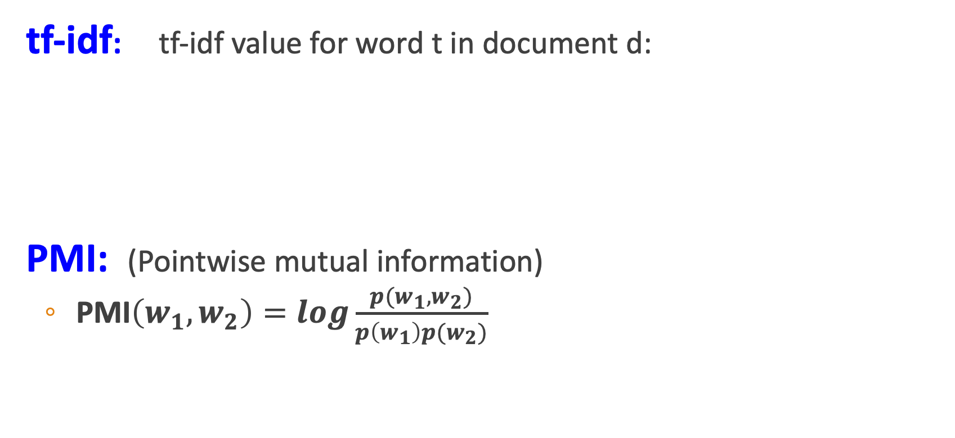
Two common solutions for word weighting
tf-idf: tf-idf value for word t in document d:
PMI: (Pointwise mutual information)
$\text{PMI}\left(w_{1},w_{2}\right)=log\frac{p(w_{1},w_{2})}{p\left(w_{1}\right)p(w_{2})}$
Words like "the" or "it" have very low idf
See if words like "good" appear more often with "great" than we would expect by chance
Notes:
There are two common solutions to this problem: the tf-idf algorithm, usually used when the dimensions are documents, and algorithms based on pointwise mutual information, or PMI (usually used when the dimensions are words). Tf-idf makes use of a special weight call the "inverse document frequency or "idf", to downweight words like "the" or "it". PMI is a statistical measure that compares the probabilities we see with what we would have expected by change.

Slide 53
Term frequency (tf)
tf_{t,d} = count(t,d)
Instead of using raw count, we squash a bit:
tf_{t,d} = log₁₀(count(t,d)+1)
Notes:
The tf-idf algorithm (the ‘-’ here is a hyphen, not a minus sign) is the product of two terms, each term capturing one of these two intuitions. The first is the term frequency: the frequency of the word t in the document d. We can just use the raw count as the term frequency: EQ
More commonly we squash the raw frequency a bit, by using the log10 of the fre- quency instead. The intuition is that a word appearing 100 times in a document doesn’t make that word 100 times more likely to be relevant to the meaning of the document. Because we can’t take the log of 0, we normally add 1 to the count:

Slide 54
Document frequency (df)
df_{t} is the number of documents t occurs in.
(note this is not collection frequency: total count across all documents)
"Romeo" is very distinctive for one Shakespeare play:
Notes:
The second factor in tf-idf is used to give a higher weight to words that occur only in a few documents. Terms that are limited to a few documents are useful for discriminating those documents from the rest of the collection; terms that occur frequently across the entire collection aren’t as helpful. The document frequency dft of a term t is the number of documents it occurs in .
Document frequency is not the same as the collection frequency of a term, which is the total number of times the word appears in the whole collection in any document. Consider in the collection of Shakespeare’s 37 plays the two words Romeo and action. The words have identical collection frequencies (they both occur 113 times in all the plays) but very different document frequencies, since Romeo only occurs in a single play. If our goal is to find documents about the romantic tribulations of Romeo, the word Romeo should be highly weighted, but not action:
Important: documents can be anything, they don't have to be original documents. For example we often treat each paragraph as a document, which lets use compute tf-idf values for

Slide 55
Inverse document frequency (idf)
N is the total number of documents
in the collection
Notes:
We emphasize discriminative words like Romeo via the inverse document fre- quency or idf term weight (Sparck Jones, 1972). The idf is defined using the frac- tion N/dft, where N is the total number of documents in the collection, and dft is the number of documents in which term t occurs. The fewer documents in which a term occurs, the higher this weight. The lowest weight of 1 is assigned to terms that occur in all the documents. Because of the large number of documents in many collections, this measure too is usually squashed with a log function. The resulting definition for inverse document frequency (idf) is thus
Here are some idf values for some words in the Shakespeare corpus, ranging from extremely informative words which occur in only one play like Romeo, to those that occur in a few like salad or Falstaff, to those which are very common like fool or so common as to be completely non-discriminative since they occur in all 37 plays like good or sweet.

Slide 56
What is a document?
Could be a play or a Wikipedia article
But for the purposes of tf-idf, documents can be anything; we often call each paragraph a document!
Notes:
It’s usually clear what counts as a document: in Shake-speare we would use a play; when processing a collection of encyclopedia articles like Wikipedia, the document is a Wikipedia page; in processing newspaper articles, the document is a single article. But very frequently you might need to break up the corpus into documents yourself for the purposes of computing idf. Because that documents can be anything, they don't have to be original documents. For example we often treat each paragraph as a document, which lets use compute tf-idf values even when we are dealing say with a single document like a book.

Slide 57
Final tf-idf weighted value for a word
Raw counts:
tf-idf:
Notes:
The tf-idf weighted value wt,d for word t in document d thus combines term
frequency tft,d with idf:
Here's the raw counts in the Shakespeare term-document matrix, and the tf-idf weighted version of the same matrix.. Note that the tf-idf values for the dimension corresponding to the word good have now all become 0; since this word appears in every document, the tf-idf algorithm leads it to be ignored. Similarly, the word fool, which appears in 36 out of the 37 plays, has a much lower weight.

Slide 58
Vector Semantics & Embeddings
TF-IDF
Notes:
We've seen how to use tf-idf weights to computing weighted vectors representing word.

Slide 59
TF-IDF on Sklearn

Slide 60
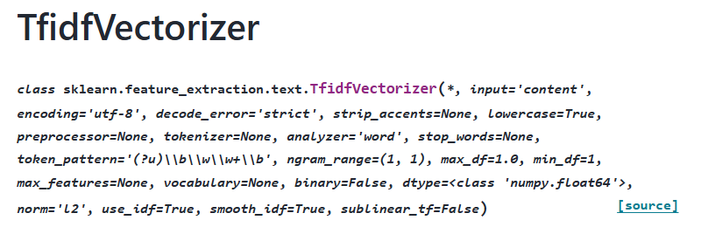
TfidfVectorizer
Sklearn contains an automatic vectorizer to learn and apply tf-idf to a set of documents

Slide 61
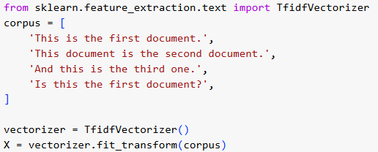
TfidfVectorizer
It works by learning the tf/idfs from a training corpus.
It can then be applied to any new test data to automatically convert into a matching vector.

Slide 62
Word-Document or Word-Word
We've talked about word-document and word-word tf-idf representations.
So which is the default sklearn vectorizer?

Slide 63
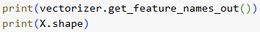

Word-Document or Word-Word
We can examine the feature names in the trained vectorizer, as well as the shape:
Word-Document or word-word?

Slide 64
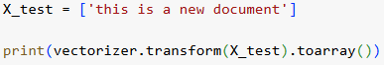

Testing
Once trained, we can apply the tf-idf vectorizer to test data

Slide 65
TF-IDF with LR Classifier
How can TF-IDF vectors be used for document classification?

Slide 66
TF-IDF with LR Classifier
How can TF-IDF vectors be used for document classification?
Convert each document (example) into a TF-IDF vector.
Use the TF-IDF vector as feature input and label as target output.
Train model and test model in this way.

Slide 67
Vector Semantics & Embeddings
PPMI

Slide 68
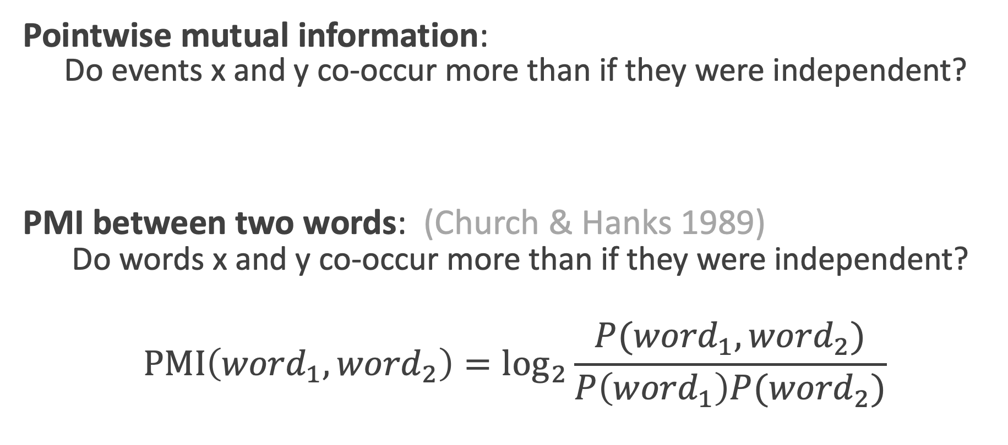
Pointwise Mutual Information
Pointwise mutual information:
Do events x and y co-occur more than if they were independent?
PMI between two words: (Church & Hanks 1989)
Do words x and y co-occur more than if they were independent?
$$\text{PMI}\left({word}_{1}, {word}_{2}\right)={\text{log}}_{2}\frac{P({word}_{1}, {word}_{2})}{P\left({word}_{1}\right)P({word}_{2})}$$

Slide 69
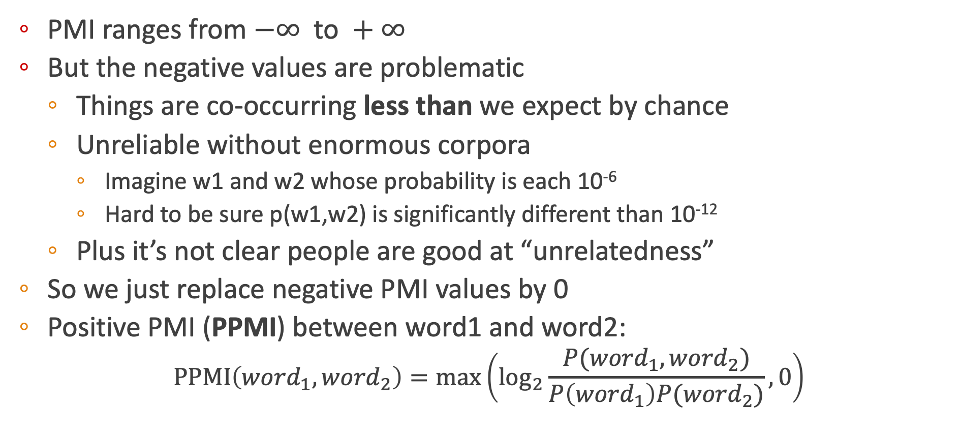
Positive Pointwise Mutual Information
PMI ranges from $−∞ \text{to} +∞$
But the negative values are problematic
Things are co-occurring less than we expect by chance
Unreliable without enormous corpora
Imagine w1 and w2 whose probability is each 10⁻⁶
Hard to be sure p(w1,w2) is significantly different than 10⁻¹²
Plus it’s not clear people are good at “unrelatedness”
So we just replace negative PMI values by 0
Positive PMI (PPMI) between word1 and word2:
$$\text{PPMI}\left({word}_{1}, {word}_{2}\right)=\max\left({\text{log}}_{2}\frac{P({word}_{1}, {word}_{2})}{P\left({word}_{1}\right)P({word}_{2})},0\right)$$

Slide 70
Computing PPMI on a term-context matrix
Matrix F with W rows (words) and C columns (contexts)
f_{ij} is # of times w_{i} occurs in context c_{j}

Slide 71
p(w=information,c=data) =
p(w=information) =
p(c=data) =
3982/111716
= .3399
7703/11716
= .6575
5673/11716
= .4842

Slide 72
pmi(information,data) = log₂ (
.3399 /
(.6575*.4842) )
= .0944
Resulting PPMI matrix (negatives replaced by 0)

Slide 73
Weighting PMI
PMI is biased toward infrequent events
Very rare words have very high PMI values
Two solutions:
Give rare words slightly higher probabilities
Use add-one smoothing (which has a similar effect)

Slide 74
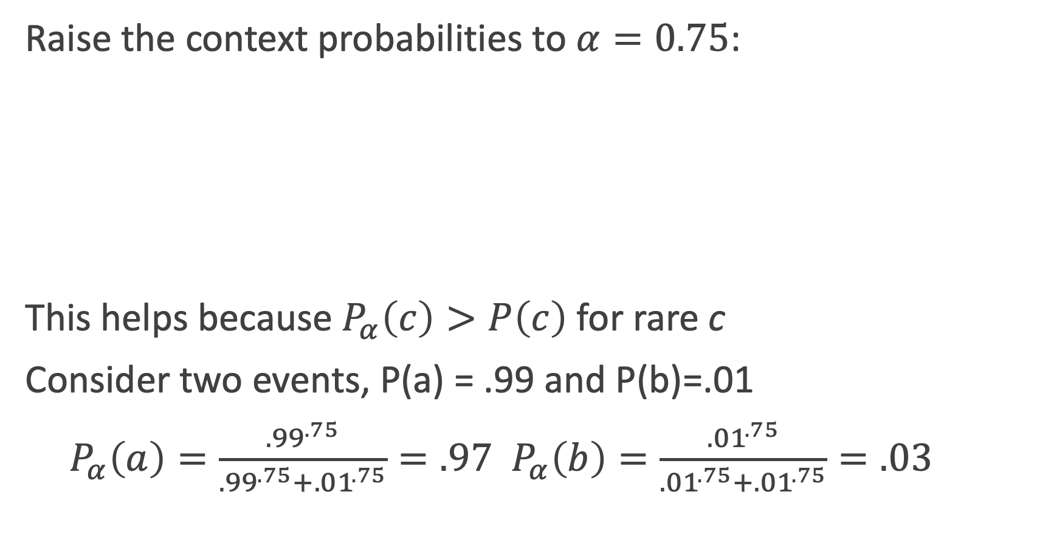
Weighting PMI: Giving rare context words slightly higher probability
Raise the context probabilities to $α=0.75$:
This helps because $P_{α}\left(c\right)>P\left(c\right)$ for rare c
Consider two events, P(a) = .99 and P(b)=.01
${ P}_{α}\left(a\right)=\frac{{.99}^{.75}}{{.99}^{.75}+{.01}^{.75}}=.97$ $P_{α}\left(b\right)=\frac{{.01}^{.75}}{{.01}^{.75}+{.01}^{.75}}=.03$

